Slide 1
Lecture 5: CSS Deep Dive

Slide 2
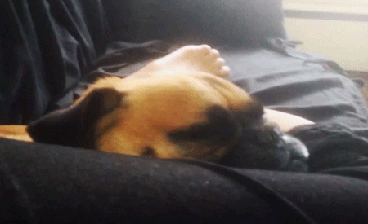
Submit Homework
I have graded up to Week 3. If you have not gotten an e-mail from me about your homework to this point than something went wrong.
Tour Dates
Media
Merch

Slide 3
CSS DD: Last Week Review
What is CSS
“History” of CSS
Revist developer tools
First External CSS file
Basic CSS:
Colors
Fonts
Typography
Selectors
Box Model
Shorthand
Layouts
Positioning
Backgrounds

Slide 4

CSS: Questions over reading
CH 12
Mobile Stylesheets
CH 14
Vendor prefixes
Browser Compatibility
Rounded corners
etc.

Slide 5
CSS DD: This week overview
Working with InVision
Advanced CSS
Rounded Corners
Shadows
Parent Child Selectors
Advanced Colors
Attribute Selectors
CSS Transitions
Backgrounds
Transforms
Gradients
Media Queries
Flexbox

Slide 6
Working with InVision

Slide 7
Prepare your design files
Open your files
Save each Canvas/Artboard
Save As “page-name”.[png, jpg, jpeg]
Ex. if I’m on the Homepage Artboard I would export my Artboard as “homepage.png”
Save your file to > project-name/exports
Ex. my project is Defones so I would save to deftones-site/exports
Make sure to also save your Overlay files too
An overlay file is for example a canvas that represents your Lightbox effect
Upload to inVision

Slide 8
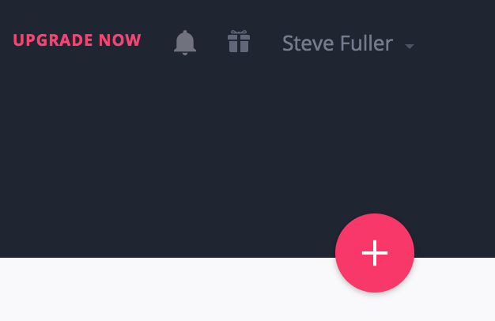
Sign Up for a Free inVision Account
Visit https://invisionapp.com
Sign up / Sign In
Click the big red button with a plus sign
Create New Prototype
Name of Project “Your Band” & Select “Desktop(Web)”
Upload your files
Drag and drop all your files in your Export folder
Optional arrange files
I like to arrange my files by my navigation order
Create prototype

Slide 9

How to create actions
Make sure to review inVisions Help Center for how tos
Main Links
Building Projects
Adding Interactivity
Articles of concern
Creating a Prototype
Upload Screens
Syncing Screens
Adding Interactivity
Prototype Screens
Replacing Screens

Slide 10

Minimum Requirements
All pages must be linked
Demonstrate Lightbox Effect
Demonstrate Filter Effect

Slide 11
Advanced CSS

Slide 12
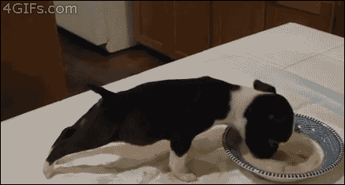
CSS Deep Dive: Advanced CSS
Rounded Corners
Shadows
Box Shadow Generator
Parent Child Selectors “Combinators”
Transparency
Colors
Images
CSS Transitions

Slide 13

CSS DD: Advanced CSS contd.
Backgrounds
Perfect background image
Transforms
Gradients
Gradients
Gradient Generator
Media Queries
@ Rule
Responsive Web Design
Flexbox
About
CSS Tricks Complete Guide

Slide 14

That’s it

Slide 15

Week 5: Homework
Build InVision prototype with final designs
Read Chapter 15
Practice Coding
Advanced CSS topics
Try installing and using Bulma
Research responsive tutorials and practice

